Slide 1


A Method for Registration of 3-D Shapes
Iterative Closest Point ( ICP )
Paper Review
발표자 : 고대걸

Slide 2
A Method for Registration of 3-D Shapes
Iterative Closest Point ( ICP ) Contents
Abstract
Introduction & Literature Review
Mathematical Preliminaries
Iterative Closest Point Algorithm
Experimental Results
Conclusion

Slide 3


A Method for Registration of 3-D Shapes
01
Abstract
Method for the accurate and computationally efficient registration of 3-D shapes
01
ICP ‘s Idea
given an adequate set of initial rotations and translations for a particular class of objects with a certain level of "shape complexity,"
one can globally minimize the mean-square distance metric over all six degrees of freedom by testing each initial registration.
02
ICP ‘s advantages
Register sensed data from un-fixtured rigid objects with an ideal geometric model prior to shape inspection.
Useful for deciding fundamental issues such as the congruence (shape equivalence) of different geometric representations
Useful for estimating the motion between point sets where the correspondences are not known.

Slide 4
A Method for Registration of 3-D Shapes
02
Introduction & Literature Review
Introduction
01
Main interests
-> Does a segmented region from a range image match a subset of B-spline surfaces?
02
Solutions
The point-set matching problem without correspondence
Free-form surface matching problem
The free-form curve matching problem
03
Considering
For purposes of simplicity and relevance to inspection applications based on thousands of digitized points,
the case of unequal uncertainty among points is not considered.
2. The removal of statistical outliers is considered a preprocessing step
3. The assumption that a high-accuracy noncontact measurement device does not generate bad data is reasonable

Slide 5

A Method for Registration of 3-D Shapes
02
Introduction & Literature Review
Main Purpose
Goal is to minimize the distance between model shape and data shape.
Optimal rotation or translation that aligns model shape and data shape.
-3D data in a sensor coordinate system.
-Model shape in model coordinate system.

Slide 6
A Method for Registration of 3-D Shapes
02
Introduction & Literature Review
Literature Review
01
02
03
04
05
This work popularized the use of quaternions for least squares registration of corresponding 3-D point sets
Limitation : It relied on the probable existence of reasonably large planar regions within a free-form shape
Developed a solution to the free-form space curve matching problem without feature extraction
Limitation : It has difficulty with very noisy curves
Solve 3-D point-set pose estimation problem using robust methods combined with the least squares SVD registration approach
developed the extended Gaussian image (EGI) methods
work in the area of implicit algebraic nonplanar 3-D estimation with applications to position estimation without feature extraction.
Limitation : Unclear that the effectiveness generalizes well to more complicated surfaces, such as terrain data or a human face.

Slide 7








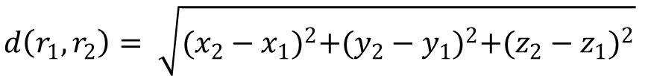
A Method for Registration of 3-D Shapes
03
Mathematical Preliminaries
A. Point to Parametric Entity Distance
B. Point to Implicit Entity Distance
Parametric entity and entity set
Implicit entity and entity set
Objective function and Newton’s formula
Objective function and formula using Lagrange
$$d\left(r_{1},r_{2}\right)= \sqrt{{(x_{2}−x_{1})}^{2}+{(y_{2}−y_{1})}^{2}+{(z_{2}−z_{1})}^{2}}$$

Slide 8
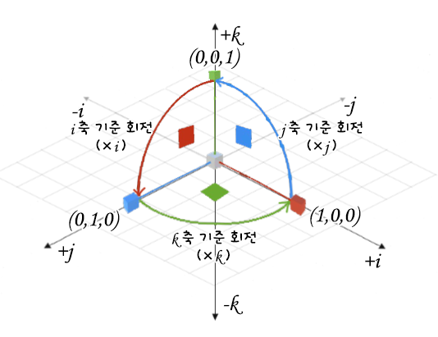

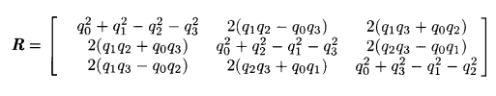
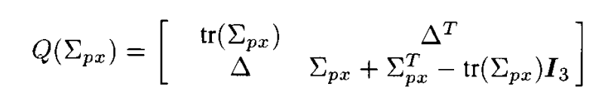
A Method for Registration of 3-D Shapes
03
Mathematical Preliminaries
C. Quaternion
C-1. Objective function and Rotation matrix
Quaternion
Objective function and Rotation matrix

Slide 9
A Method for Registration of 3-D Shapes
04
Iterative Closest Point Algorithm
Mechanism of the ICP

Slide 10








A Method for Registration of 3-D Shapes
04
Iterative Closest Point Algorithm
Mechanism of the ICP
Convergence Theorem
01
02
03
04
Compute the closest points
Compute the registration
Apply the registration
Terminate the iteration
Registration

Slide 11
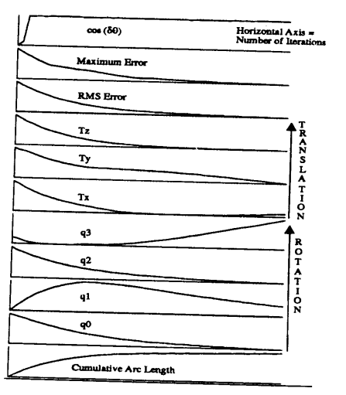
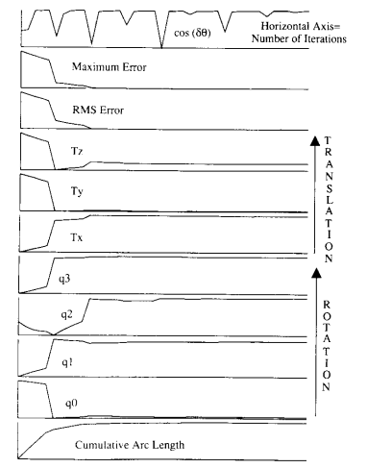
A Method for Registration of 3-D Shapes
04
Iterative Closest Point Algorithm
Accelerated ICP Algorithm

Slide 12
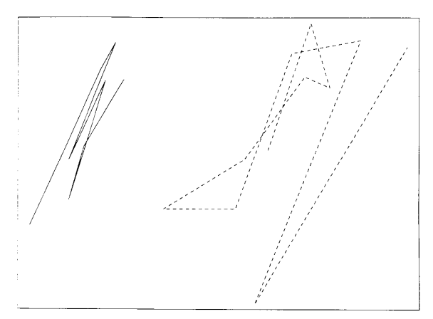
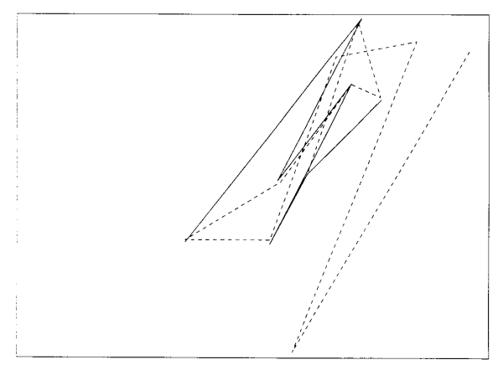
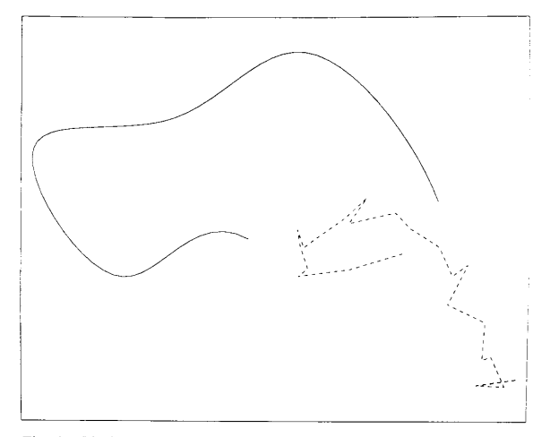
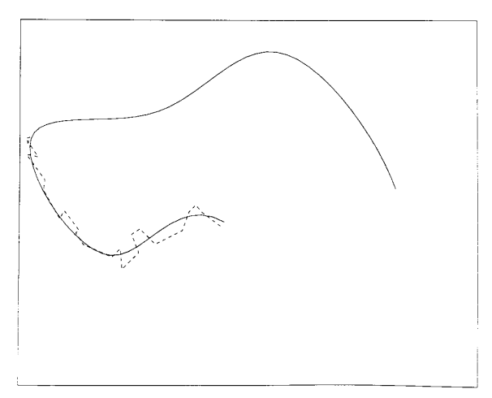
A Method for Registration of 3-D Shapes
04
Experimental Results
Point Set Matching
Curve Matching

Slide 13
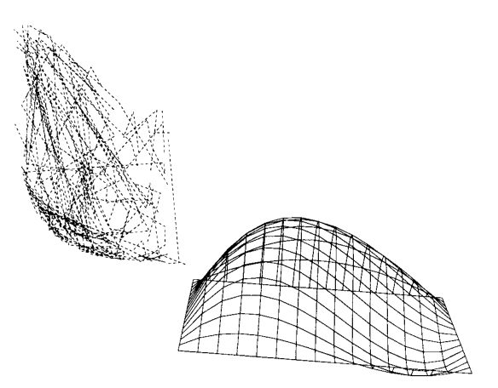
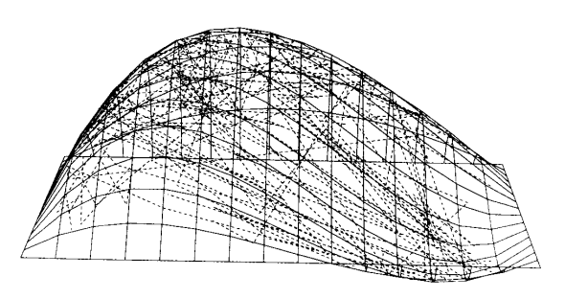
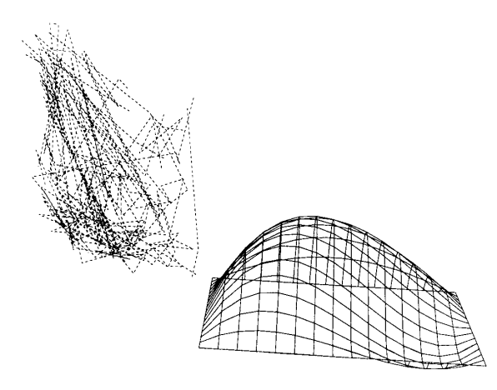
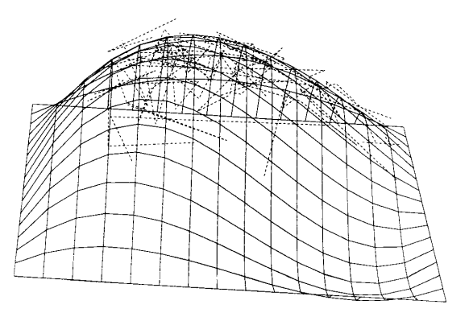
A Method for Registration of 3-D Shapes
04
Experimental Results
Surface Matching

Slide 14
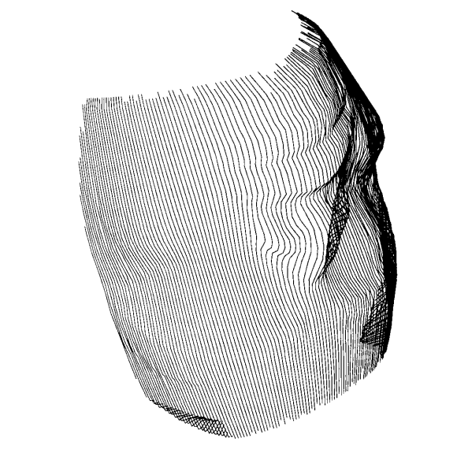
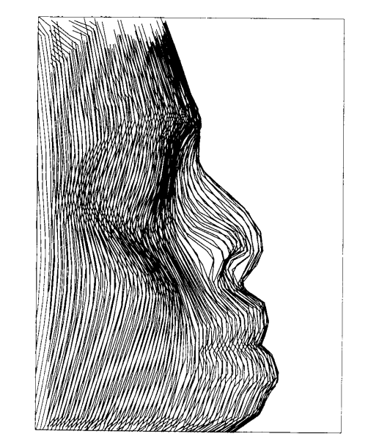
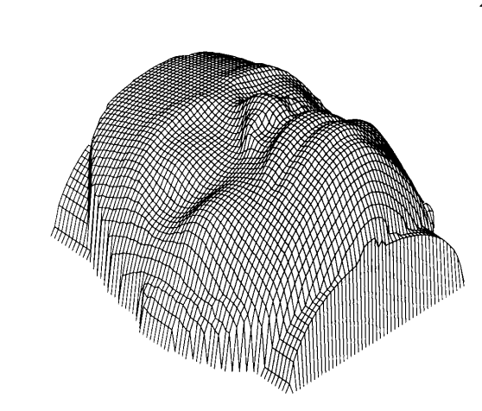
A Method for Registration of 3-D Shapes
04
Experimental Results
Surface Matching

Slide 15
A Method for Registration of 3-D Shapes
05
Conclusion
01
Advantages
02
Disadvantage
03
Limitation
Ignore
Generalization
Cost
Unique Value
Time
Same
SLAM?

Slide 16
Thank you for listening

